Slide 1
HousingPrice Prediction PPT
A PowerPoint presentation containing problem statement and understanding, EDA steps and visualizations, Steps and assumptions used to complete the project, model dashboard, finalized model, and conclusion.

Slide 2
Problem Statement
Houses are one of the necessary need of each and every person around the globe and therefore housing and real estate market is one of the markets which is one of the major contributors in the world’s economy. It is a very large market and there are various companies working in the domain. Data science comes as a very important tool to solve problems in the domain to help the companies increase their overall revenue, profits, improving their marketing strategies and focusing on changing trends in house sales and purchases. Predictive modelling, Market mix modelling, recommendation systems are some of the machine learning techniques used for achieving the business goals for housing companies. Our problem is related to one such housing company.
A US-based housing company named Surprise Housing has decided to enter the Australian market. The company uses data analytics to purchase houses at a price below their actual values and flip them at a higher price. For the same purpose, the company has collected a data set from the sale of houses in Australia

Slide 3
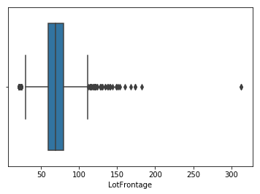
Data Visualization

Slide 4
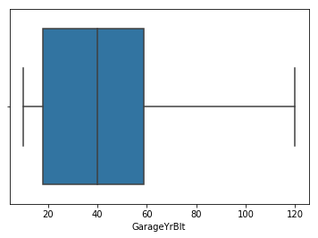

Slide 5
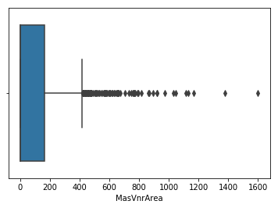

Slide 7
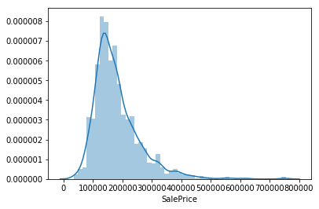

Slide 8
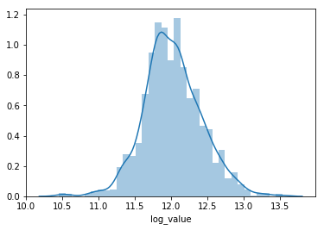

Slide 9
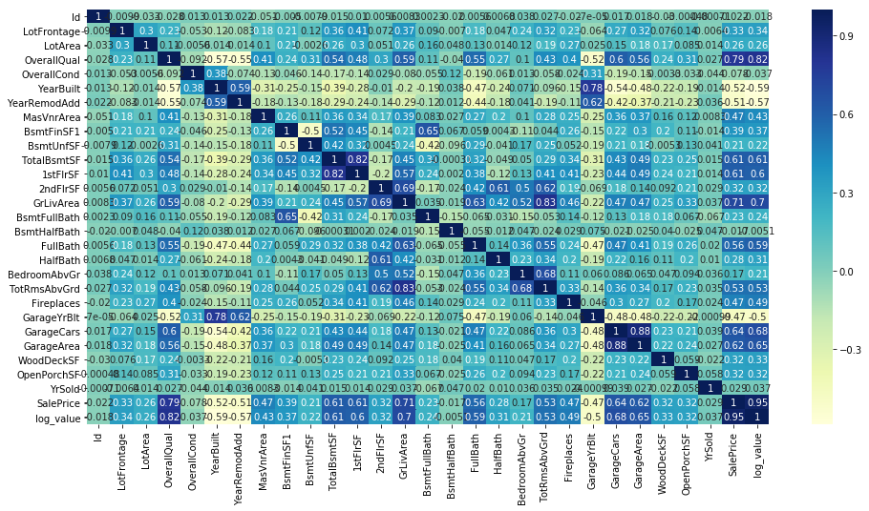

Slide 10
Model’s Training
Model’s used for the classification and regression

Slide 11
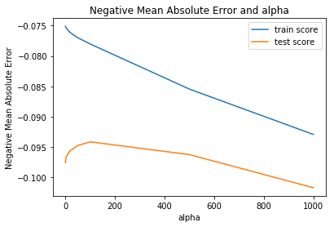
1. Ridge Classification Model –
Regression is a modeling task that involves predicting a numeric value given an input.Ridge Regression is an extension of linear regression that adds a regularization penalty to the loss function during training.
Ridge regression is the method used for the analysis of multicollinearity in multiple regression data. It is most suitable when a data set contains a higher number of predictor variables than the number of observations. The second-best scenario is when multicollinearity is experienced in a set.

Slide 12

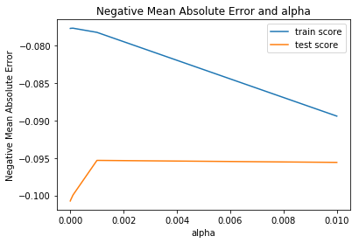
2. Lasso Model –
Lasso Regression is a popular type of regularized linear regression that includes an L1 penalty. This has the effect of shrinking the coefficients for those input variables that do not contribute much to the prediction task.
The lasso regression allows you to shrink or regularize these coefficients to avoid overfitting and make them work better on different datasets. This type of regression is used when the dataset shows high multicollinearity or when you want to automate variable elimination and feature selection.

Slide 13
Conclusion
So here 'Lasso Model' is the best model out of all model tested above and Number of predictors selected by double the optimal alpha for lasso are:129

